Slide 1
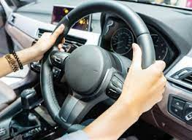
DCS Drivers Education Presentation
Presenters: Amy Hannafan and Jared Tiffin
Notes:
-Thank you for having us
-Share a little about the returning Driver Education Program

Slide 2
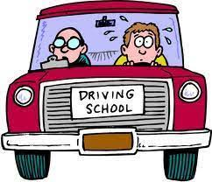
Instructor and School Responsibilities
Educated instructors
Permanent certification
MV-283 Certificate from NYSED-DTSE
Renew course every 3 years… by DeRuyter Administration
Retrofitted school van
Notes:
-Took four courses through BCC in order to become permanently certified Driver Education Teachers.
-Permanently certified to teach:
…Driver Education
…five-hour course
…work for driving schools (better than driving school instructors because they can only teach behind the wheel and not the classroom time)
-The course needs to be renewed every three years (Responsibility of the Administration).
-The school purchased safety equipment to retrofit the school van to meet the needs of the driver education course.

Slide 3

General Information
Two 4-Week Sessions
  Session 1: 7/5/22 - 7/26/22 (July 27-29 make-ups)
  Session 2: 8/1/22 - 8/22/22 (August 23-25 make-ups)
48-hour sessions
  24 hours of Classroom Instruction
  24 hours of Behind-the-Wheel Instruction
Mandatory attendance ($25 make-up fee for ONE absence only)
3-hour daily commitment for students (90 minute max)
Notes:
-Decided on 2 sessions to meet more students…birthdays, vacations, work, etc.
-Each student receives 48 total hours of instruction (lecture vs. BTW)
-Attendance policy…discuss make-ups and skills taught… >1 absence automatic drop
-Limited to 90 minutes of lecture/day and 90 minutes BTW/day

Slide 4

Typical Day
8 students Total per Session (Estimated) *NYS Law: 4 students max/car
Group 1 = 4 students
Group 2 = 4 Students
8:00 - 9:30 am………………….. Behind-the-Wheel (Group 1)
10:00 - 11:30 am………………………... Lecture (Group 1 and 2)
12:00 - 1:30 pm………….…….. Behind-the-Wheel (Group 2)
Notes:
-Limits sessions to 8 students without 2 vehicles.
-Two sessions allows us to reach 16 students this summer

Slide 5
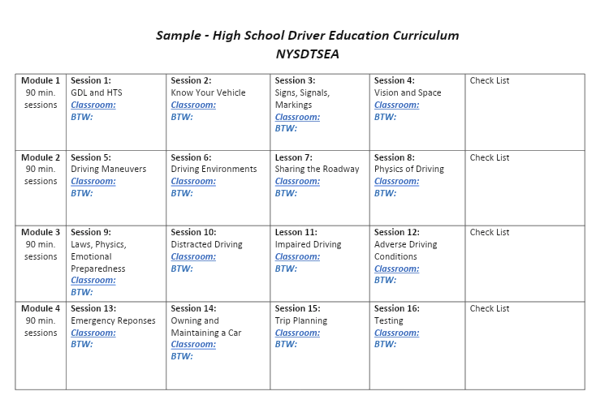
Notes:
-Class Break Down Lecture: 16 Sessions Total
-Each day focuses on a particular driving skill…sample curriculum

Slide 6
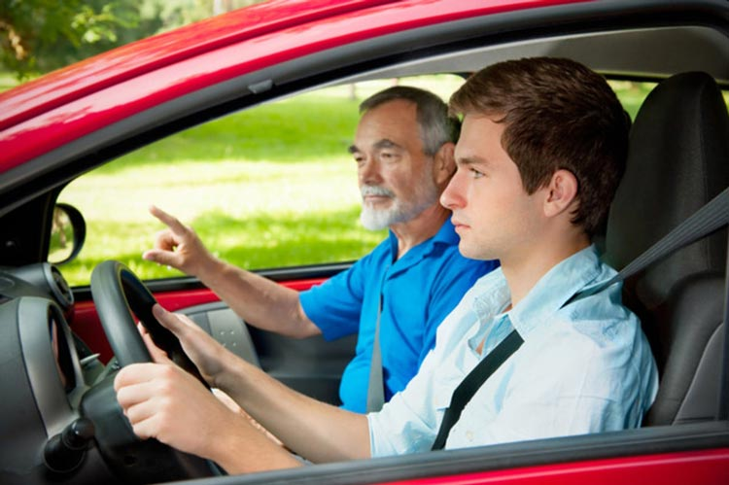
Class Break Down Behind the Wheel: 16 Sessions Total
Skills To Be Taught (Not Limited To):
Get-to-know your vehicle Lane Changes Rural Driving Pavement Markings City Driving Signs Highway Driving Proper Head Checks K-Turn | Correct Hand Position Parallel Parking Emotional Driving Parking on Hills Night Driving (Discussion) Left Turns/Right Turns Inclement Weather Driving Backing up Sharing the Road
Notes:
-Lots of information to teach
-Simulator discussion to supplement summer driving program.

Slide 7

Benefits of Completing Driver’s Education
High School Elective Credit (½ credit)
Graduated License at age 17 instead of 18
Possible insurance reduction
MV-285 certificate presented upon completion of course
Replaces the 5-hour course
Notes:
-High School Elective credit (½ credit)
-GDL at 17 vs. 18 … drive at night and with people in the car
-Insurance
-Certificate upon completion
-No need for 5-hour course
***Plan to hold a 5-hour course possible in the Fall/Winter

Slide 8
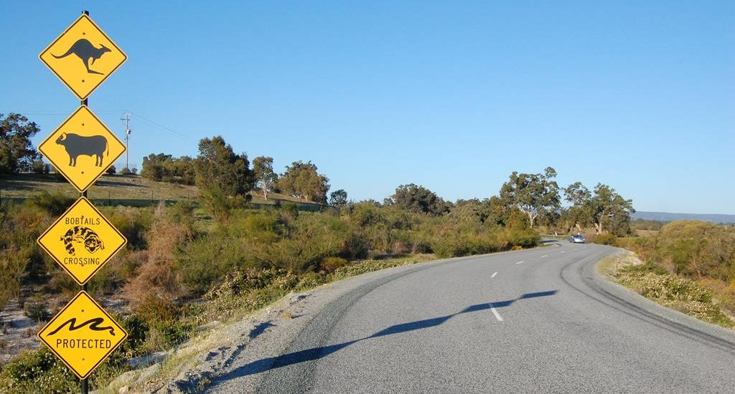
Next steps…
Parent meeting (6/21/22 at 6 pm)
Maintaining records to be held by the school for 6 years
Retrofit van
Curriculum Planning hours
Route Planning
Scheduling students
Notes:
-Mandatory parent night…sign contract
-Schedule students for Session and Group
-Plan routes
-Curriculum planning (30 hours)
-Retrofit van (Terry)
-All records (logs, attendance, instructor) kept for 6 years

Slide 9
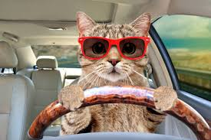
Thank you for your time.
Drive safely!

